Slide 1
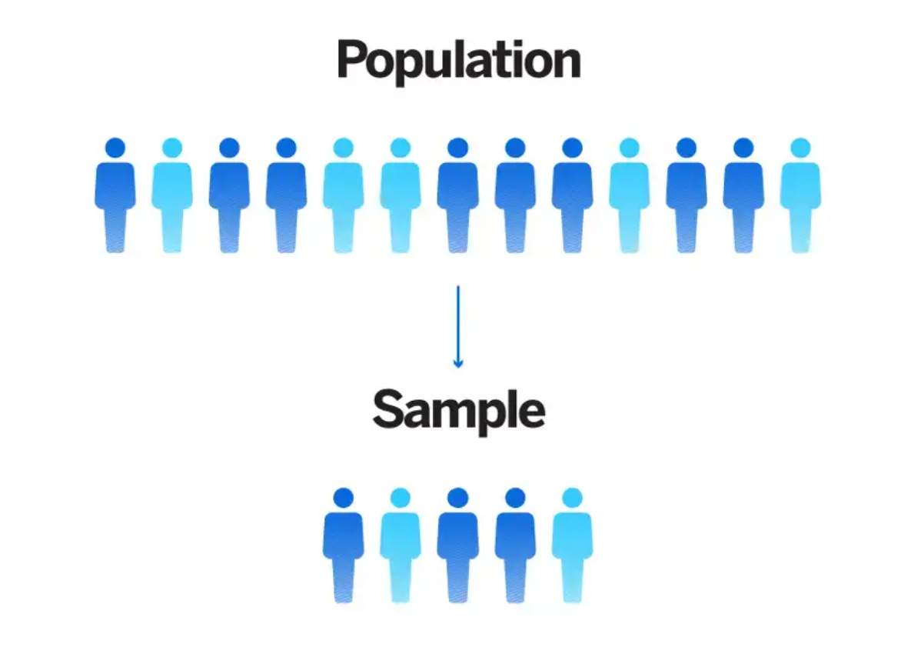
Research Methodology
DR. FAHEEM AKHTAR
Ph.D. (Zhejiang University)
Assistant Professor

Slide 2
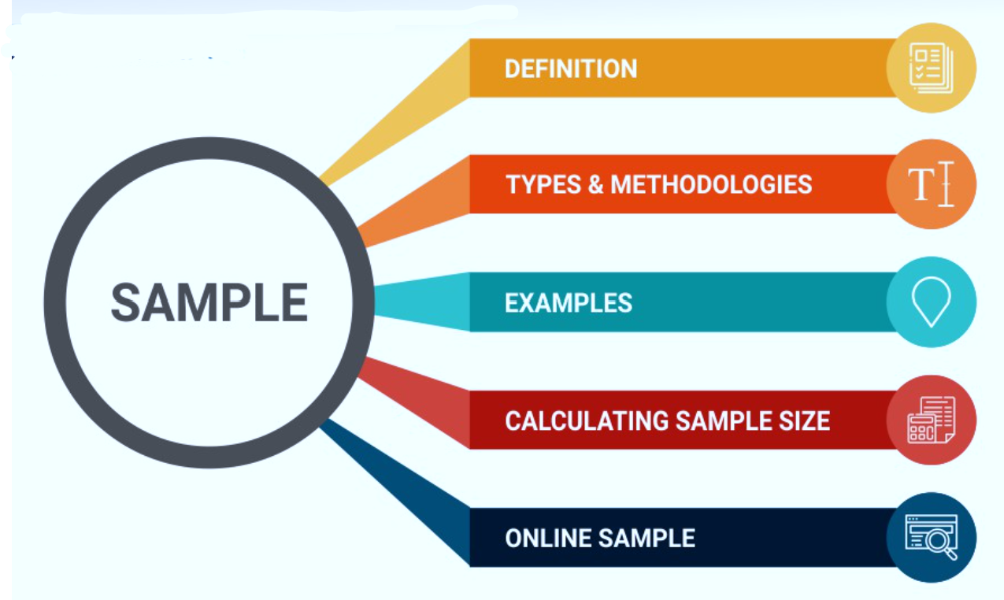

Slide 3
WHAT IS SAMPLING
A sample is a smaller set of data that a researcher chooses or selects from a larger population using a pre-defined selection bias method. These elements are known as sample points, sampling units, or observations.
WHY SAMPLING REQUIRED
Creating a sample is an efficient method of conducting research. Researching the whole population is often impossible, costly, and time-consuming. Hence, examining the sample provides insights the researcher can apply to the entire population.

Slide 4
WHY SAMPLING REQUIRED
For example, if a cell phone manufacturer wants to conduct a feature research study among students in US Universities. An in-depth research study must be conducted if the researcher is looking for features that the students use, features they would like to see, and the price they are willing to pay.
This step is imperative to understand the features that need development, the features that require an upgrade, the device’s pricing, and the go-to-market strategy.
In 2016/17 alone, there were 24.7 million students enrolled in universities across the US. It is impossible to research all these students; the time spent would make the new device redundant, and the money spent on development would render the study useless.
Creating a sample of universities by geographical location and further creating a sample of these students from these universities provides a large enough number of students for research.

Slide 5
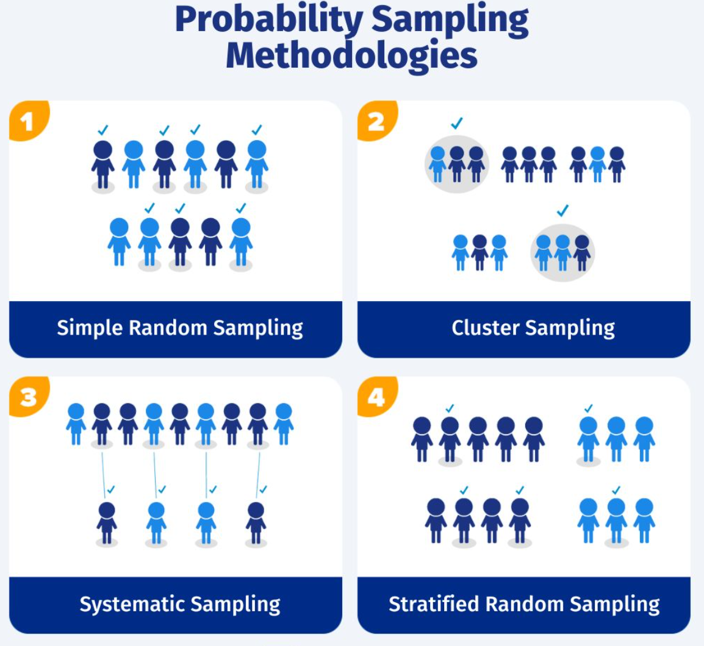
TYPES OF SAMPLING
1. Probability Sampling
Probability sampling is a method of deriving a sample where the objects are selected from a population-based on probability theory. This method includes everyone in the population, and everyone has an equal chance of being selected. Hence, there is no bias whatsoever in this type of sample.

Slide 6
TYPES OF SAMPLING
1. Probability Sampling
1.1 Simple random sampling
For example, if a university dean would like to collect feedback from students about their perception of the teachers and level of education, all 1000 students in the University could be a part of this sample. Any 100 students can be selected randomly to be a part of this sample.
The most straightforward way of selecting a sample is simple random sampling. In this method, each member has an equal chance of participating in the study. The objects in this sample population are chosen randomly, and each member has the same probability of being selected.

Slide 7
TYPES OF SAMPLING
1. Probability Sampling
1.2 Cluster Sampling
For example, if the Food and Drug Administration wants to collect data about adverse side effects from drugs, they can divide the mainland US into distinctive cluster analysis, like states. Research studies are then administered to respondents in these clusters. This type of generating a sample makes the data collection in-depth and provides easy-to-consume and act-upon, insights.
Cluster sampling: Cluster sampling is a type of sampling method where the respondent population is divided into equal clusters. Clusters are identified and included in a sample based on defining demographic parameters such as age, location, sex, etc. This makes it extremely easy for a survey creator to derive practical inferences from the feedback.

Slide 8
TYPES OF SAMPLING
1. Probability Sampling
1.3 Systematic Sampling
For example, while selecting 1,000 volunteers for the Olympics from an application list of 10,000 people, each applicant is given a count of 1 to 10,000. Then starting from 1 and selecting each respondent with an interval of 10, a sample of 1,000 volunteers can be obtained.
Systematic sampling is a sampling method where the researcher chooses respondents at equal intervals from a population. The approach to selecting the sample is to pick a starting point and then pick respondents at a pre-defined sample interval.

Slide 9
TYPES OF SAMPLING
1. Probability Sampling
1.4 Stratified random sampling
For example, a researcher looking to analyze people from different socioeconomic backgrounds can distinguish respondents by their annual salaries. This forms smaller groups of people or samples, and then some objects from these samples can be used for the research study.
Stratified random sampling is a method of dividing the respondent population into distinctive but pre-defined parameters in the research design phase. In this method, the respondents don’t overlap but collectively represent the whole population.

Slide 10
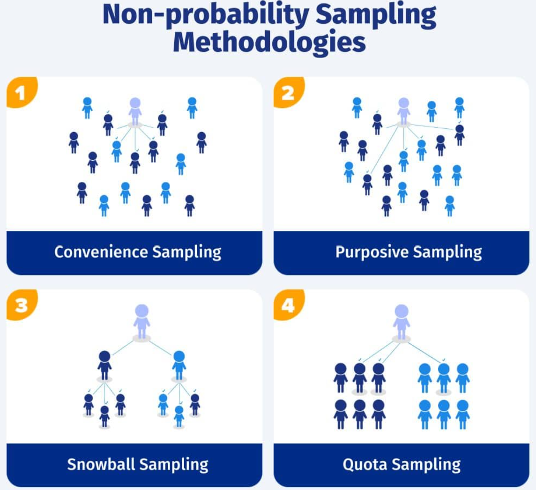
TYPES OF SAMPLING
2. Non-probability sampling
The non-probability sampling method uses the researcher’s discretion to select a sample. This type of sample is derived mostly from the researcher’s or statistician’s ability to get to this sample.

Slide 11
TYPES OF SAMPLING
2. Non-probability sampling
2.1 Convenience sampling
This non-probability sampling method is used when there is time and costs limitations in collecting feedback. For example, researchers that are conducting a mall-intercept survey to understand the probability of using a fragrance from a perfume manufacturer. In this sampling method, the sample respondents are chosen based on their proximity to the survey desk and willingness to participate in the research.
Convenience sampling, in easy terms, stands for the convenience of a researcher accessing a respondent. There is no scientific method for deriving this sample. Researchers have nearly no authority over selecting the sample elements, and it’s purely done based on proximity and not representativeness.

Slide 12
TYPES OF SAMPLING
2. Non-probability sampling
2.2 Judgmental/purposive sampling
The judgmental or purposive sampling method is a method of developing a sample purely on the basis and discretion of the researcher purely, based on the nature of the study along with his/her understanding of the target audience. This sampling method selects people who only fit the research criteria and end objectives, and the remaining are kept out.
For example, if the research topic is understanding what University a student prefers for Masters, if the question asked is “Would you like to do your Masters?” anything other than a response, “Yes” to this question, everyone else is excluded from this study.

Slide 13
TYPES OF SAMPLING
2. Non-probability sampling
2.3 Snowball sampling
For example, while collecting feedback about a sensitive topic like AIDS, respondents aren’t forthcoming with information. In this case, the researcher can recruit people with an understanding or knowledge of such people and collect information from them or ask them to collect information.
Snowball sampling or chain-referral sampling is defined as a non-probability sampling technique in which the samples have rare traits. This is a sampling technique in which existing subjects provide referrals to recruit samples required for a research study.

Slide 14
TYPES OF SAMPLING
2. Non-probability sampling
2.4 Quota sampling
For example, when a shoe manufacturer would like to understand millennials’ perception of the brand with other parameters like comfort, pricing, etc. It selects only females who are millennials for this study as the research objective is to collect feedback about women’s shoes.
Quota sampling is a method of collecting a sample where the researcher has the liberty to select a sample based on their strata. The primary characteristic of this method is that two people cannot exist under two different conditions.

Slide 15
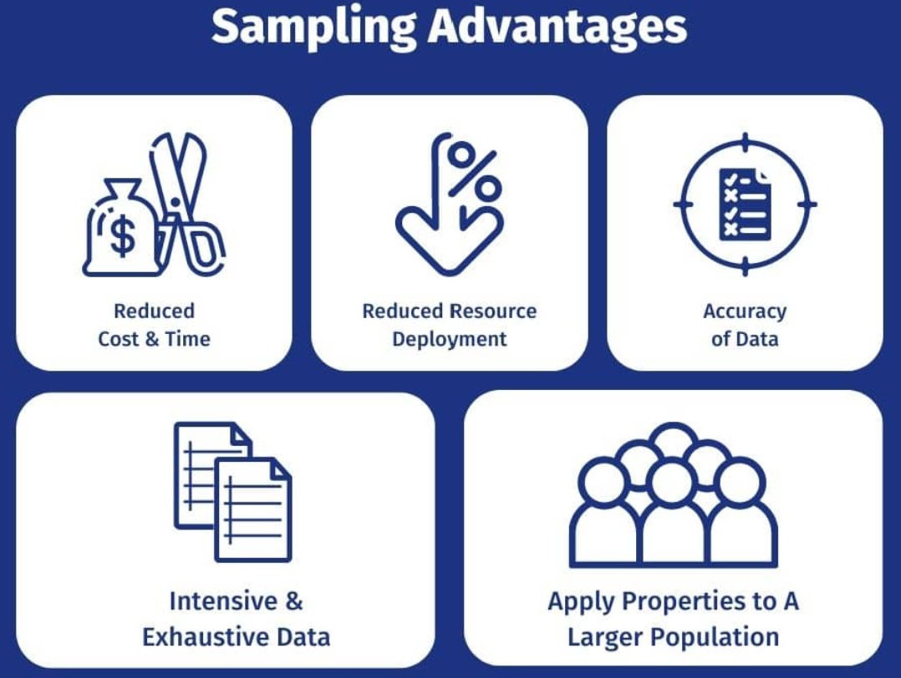

Slide 16
Sampling Advantages
Reduced cost & time
Reduced resource deployment
Since using a sample reduces the number of people that have to be reached out to, it reduces cost and time. Imagine the time saved between researching with a population of millions vs. conducting a research study using a sample.
It is obvious that if the number of people involved in a research study is much lower due to the sample, the resources required are also much less. The workforce needed to research the sample is much less than the workforce needed to study the whole population.

Slide 17
Sampling Advantages
Accuracy of data
Intensive & exhaustive data
Since the sample indicates the population, the data collected is accurate. Also, since the respondent is willing to participate, the survey dropout rate is much lower, which increases the validity and accuracy of the data.
Since there are lesser respondents, the data collected from a sample is intense and thorough. More time and effort are given to each respondent rather than collecting data from many people.

Slide 18
Sampling Advantages
Apply properties to a larger population
Since the sample is indicative of the broader population, it is safe to say that the data collected and analyzed from the sample can be applied to the larger population, which would hold true.

Slide 19
Sample Size Determination?
Sample size determination is choosing the correct number of observations or people from a larger group to use in a sample. The goal of figuring out the sample size is to ensure that the sample is big enough to give statistically valid results and accurate estimates of population parameters but small enough to be manageable and cost-effective.
Choosing the statistically significant sample size depends on a number of things, such as the size of the population, how precise you want your estimates to be, how confident you want to be in the results, how different the population is likely to be, and how much money and time you have for the study. Statistics are often used to determine a sample size for a certain type of study and research question.

Slide 20
Sample Size Determination
Sample size determination is choosing the correct number of observations or people from a larger group to use in a sample. The goal of figuring out the sample size is to ensure that the sample is big enough to give statistically valid results and accurate estimates of population parameters but small enough to be manageable and cost-effective.
Choosing the statistically significant sample size depends on a number of things, such as the size of the population, how precise you want your estimates to be, how confident you want to be in the results, how different the population is likely to be, and how much money and time you have for the study. Statistics are often used to determine a sample size for a certain type of study and research question.

Slide 21
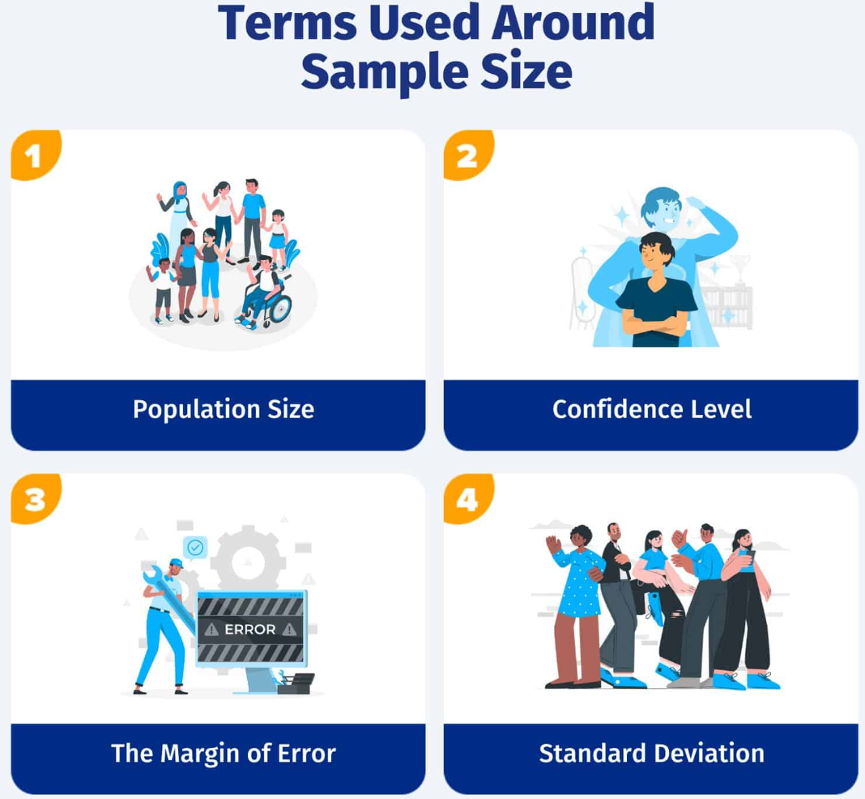
How to determine a Sample Size?
To understand all of this and make an informed calculation of the right sample size, it is first essential to understand four important variables that form the basic characteristics of a sample.

Slide 22
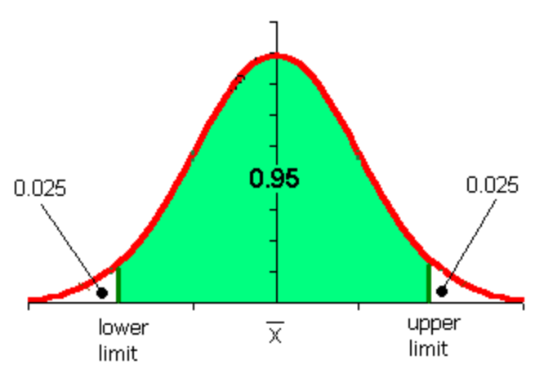
How to determine a Sample Size?
1. Population size:
Population size is how many people fit your demographic. For example, you want to get information on doctors residing in North America. Your population size is the total number of doctors in North America.
2. Confidence level:
The confidence level tells you how sure you can be that your data is accurate. It is expressed as a percentage and aligned to the confidence interval. For example, if your confidence level is 90%, your results will most likely be 90% accurate.

Slide 23
How to determine a Sample Size?
3. The margin of error (confidence interval):
There’s no way to be 100% accurate when it comes to surveys. Confidence intervals tell you how far off from the population means you’re willing to allow your data to fall.
A margin of error describes how close you can reasonably expect a survey result to fall relative to the real population value.

Slide 24
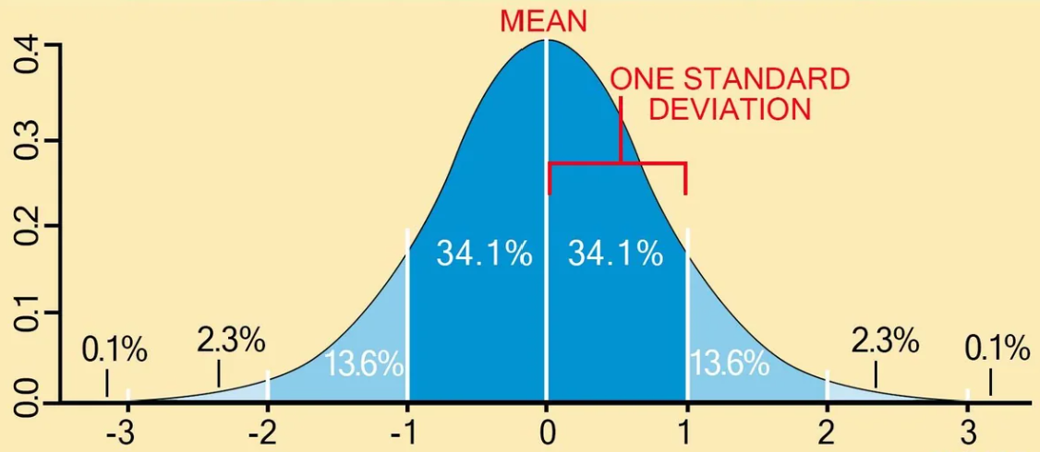
How to determine a Sample Size?
4. Standard deviation:
Standard deviation is the measure of the dispersion of a data set from its mean. It measures the absolute variability of a distribution. The higher the dispersion or variability, the greater the standard deviation and the greater the magnitude of the deviation.
For example, you have already sent out your survey. How much variance do you expect in your responses? That variation in response is the standard deviation.
Standard deviation is a statistical measurement of the amount a number varies from the average number in a series. A low standard deviation means that the data is very closely related to the average, thus very reliable. A high standard deviation means that there is a large variance between the data and the statistical average, and is not as reliable.

Slide 25
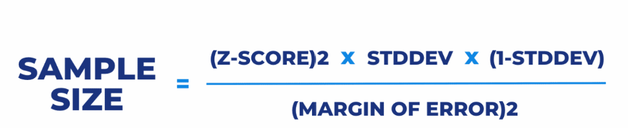
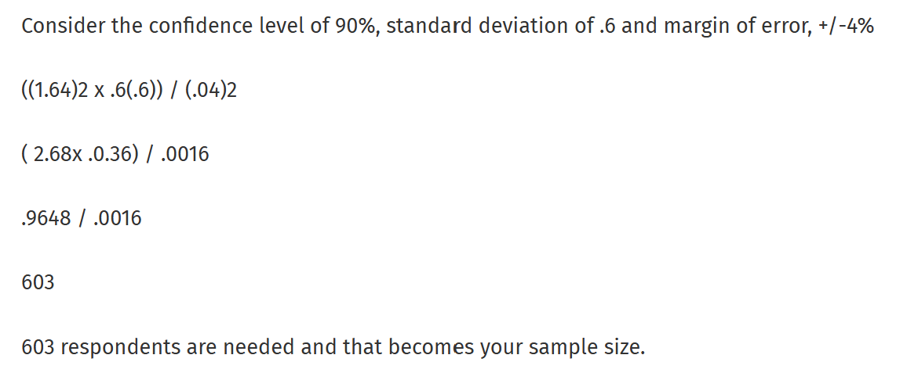
Sample Size Calculation Formula – Sample Size Determination

Slide 26
Thanks

